Slide 1
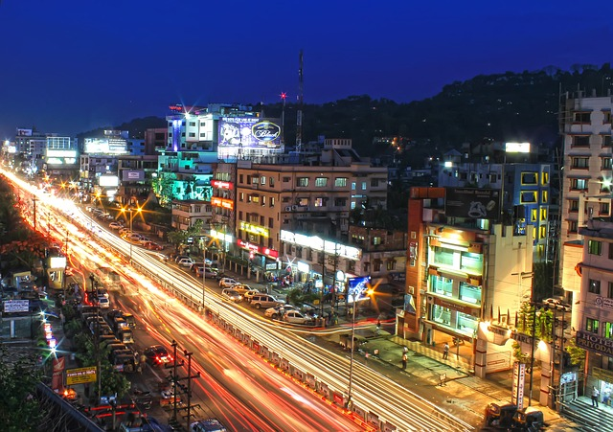
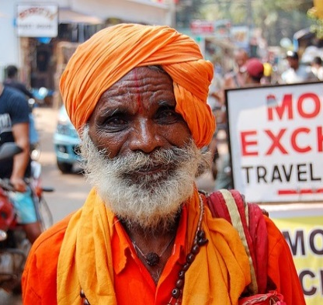
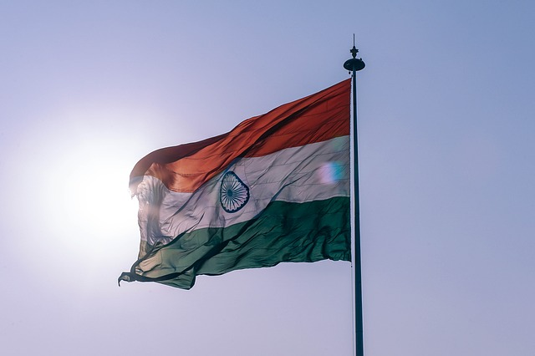
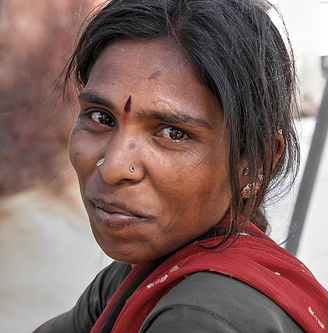
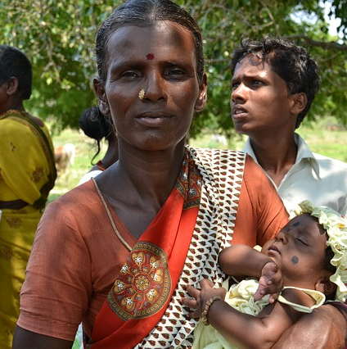
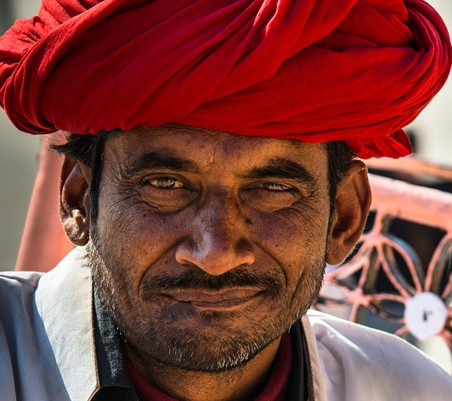
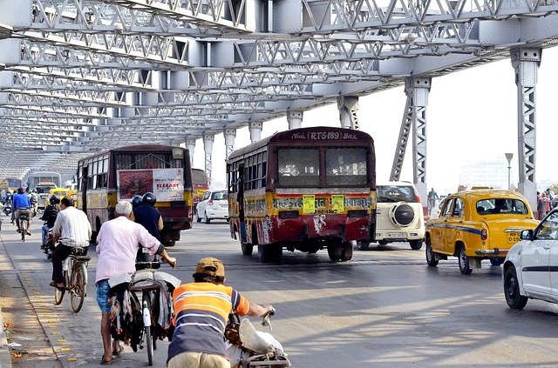
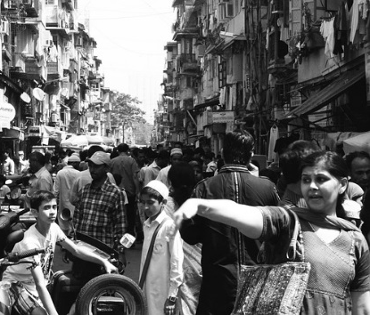
ANALYTICAL DEMOCRACY
Notes:
Source Images:-
https://pixabay.com/en/people-woman-call-shop-coffee-2588594/
https://pixabay.com/en/african-descent-business-cheerful-2477763/
https://pixabay.com/en/man-white-shirt-male-person-young-1342457/
https://pixabay.com/en/squad-man-group-group-together-3370836/
https://pixabay.com/en/entrepreneur-startup-start-up-man-593362/
https://pixabay.com/en/women-working-face-portrait-office-2900989/
https://pixabay.com/en/business-lady-woman-girl-computer-3560916/
https://pixabay.com/en/man-white-shirt-male-person-young-1342457/
https://pixabay.com/en/language-school-team-interns-834138/

Slide 2

General Election 2019 Predictive Analysis
Verdict of the Indian Citizens
NDA will be very close to the majority mark. And, with other parties such as AIADMK, BJD, and TRS supporting BJP, they might cross the magic figure of 300.
A Sheer Analytics and Insights research and predictive analysis © Sheer Analytics and Insights Pvt. Ltd.

Slide 3
General Election 2019 Predictive Analysis
Key Factors in favour of Ruling Government
Key Factors in favour of Opposition
Impact of Balakot on general mass
Loss of political narrative of the opposition post Balakot
Huge number of swing voters amongst urban voters who are affected by short-term developments
Impact of A-SAT is fresh and might influence urban voters
Half of the election takes place in the month of May. The impact of the new tax regime will be seen in the April salary of most urban voters. The significant savings due to reduced tax regime which will lead to no tax for a huge number of professionals will have an impact on urban areas.
Amongst the rural population a divided opposition without any distinctive issue based politics will reduce opposition’s chances.
Since the last 5 state assembly elections NDA government will expect to gain around 4 – 5 % of the vote share from the 5 states that went to poll. This is decisive in states like Chhattisgarh, Madhya Pradesh, and UP.
Failure of Congress to create or join any alliance, and, multi-pronged elections will favour the ruling government.
The swing of 3 – 4% votes back to BJP would be huge gains in the Hindi belt than earlier predicted.
The opposition has lost significant ground in state of Maharashtra, and, BJP and Shiv Sena alliance in the state is expected to sweep the state. There is no political narrative of the opposition to counter this alliance.
For opposition in states like UP with SP and BSP coming together the arithmetic of election would be against the ruling party, as seen in the Gorakhpur case, where NDA gained 6% vote from the last election but still lost out because of consolidation of BSP and SP votes.
The loss of Rajasthan, Madhya Pradesh and Chhattisgarh would mean Congress would be in control of the state machinery when these three states go to polls. The same would be also happening in state like Karnataka.
Anti-incumbency might play a role in states of Bihar and definitely Jharkhand. In the state of Jharkhand there is visible discontent against the ruling government of the state.
A Sheer Analytics and Insights research and predictive analysis © Sheer Analytics and Insights Pvt. Ltd.

Slide 4
General Election 2019 Predictive Analysis
Uttar Pradesh
Total
Lok Sabha Seats
80
A Sheer Analytics and Insights research and predictive analysis © Sheer Analytics and Insights Pvt. Ltd.

Slide 5
General Election 2019 Predictive Analysis
Bihar
Total
Lok Sabha Seats
40
A Sheer Analytics and Insights research and predictive analysis © Sheer Analytics and Insights Pvt. Ltd.

Slide 6
General Election 2019 Predictive Analysis
Jharkhand
Special Factor:
Refusing a ticket to honest long-term serving members like Kariya Munda (seven-time MP) will have negative impact on people’s mindsets against BJP. There has been a question mark on the candidature of many from BJP in Jharkhand, and that will also impact negatively the people’s mindset.
Total
Lok Sabha Seats
14
A Sheer Analytics and Insights research and predictive analysis © Sheer Analytics and Insights Pvt. Ltd.

Slide 7
General Election 2019 Predictive Analysis
Maharashtra
Total
Lok Sabha Seats
48
A Sheer Analytics and Insights research and predictive analysis © Sheer Analytics and Insights Pvt. Ltd.

Slide 8
General Election 2019 Predictive Analysis
West Bengal
Total
Lok Sabha Seats
42
A Sheer Analytics and Insights research and predictive analysis © Sheer Analytics and Insights Pvt. Ltd.

Slide 9
General Election 2019 Predictive Analysis
Key Factors in West Bengal
There is anti-incumbency in the state which the Trinamul government refuses to address. However, in an election that would be held under the vigil of CEC and Central Forces this discontent might suffice. Trinamul has not allowed this discontent to surface in the past during panchayat, municipal/assembly election, and hence, the central Lok Sabha election might act as a vent for even grassroot issues.
Trinamul has underestimated the power of BJP in the state. If BJP cadres, according to the local MLA, has the audacity to destroy Trinamul offices in a Trinamul bastion like Tamluk, then there is a cause of worry for the state government.
A lot of BJP candidates who were unknown in 2014 have become household names. People know the names of these candidates. And, this would bring up the vote share by 2 – 3% in favour of BJP.
TMC with 34 seats in the parliamentary election did not have any power to bargain development for the state. They could not play significant role in the opposition as well in terms of policy issues. One MP who became minister of state had more impact towards the cause of the state than 34 MPs of TMC. People might take cognizance of this. However, TMC will still win the state although it might lose 6 – 8 seats in the state.
A Sheer Analytics and Insights research and predictive analysis © Sheer Analytics and Insights Pvt. Ltd.

Slide 10
General Election 2019 Predictive Analysis
This election forecast is based on predictive analysis after analyzing factors favouring and disrupting the cause of each and every political party per seat.
The data for the predictive analytics has been collected through a survey and then each and every driving and restraining factor has been quantified with each favourite political party per seat.
A Sheer Analytics and Insights research and predictive analysis © Sheer Analytics and Insights Pvt. Ltd.

